Slide 1
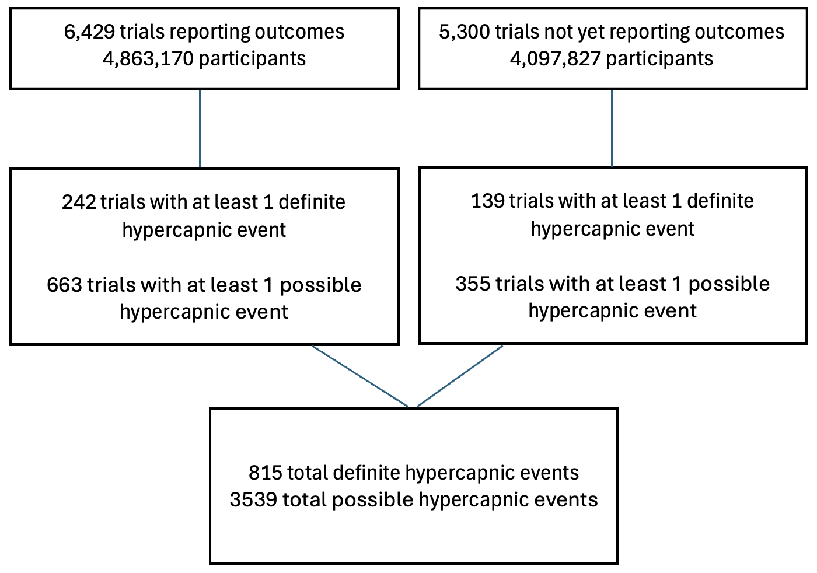
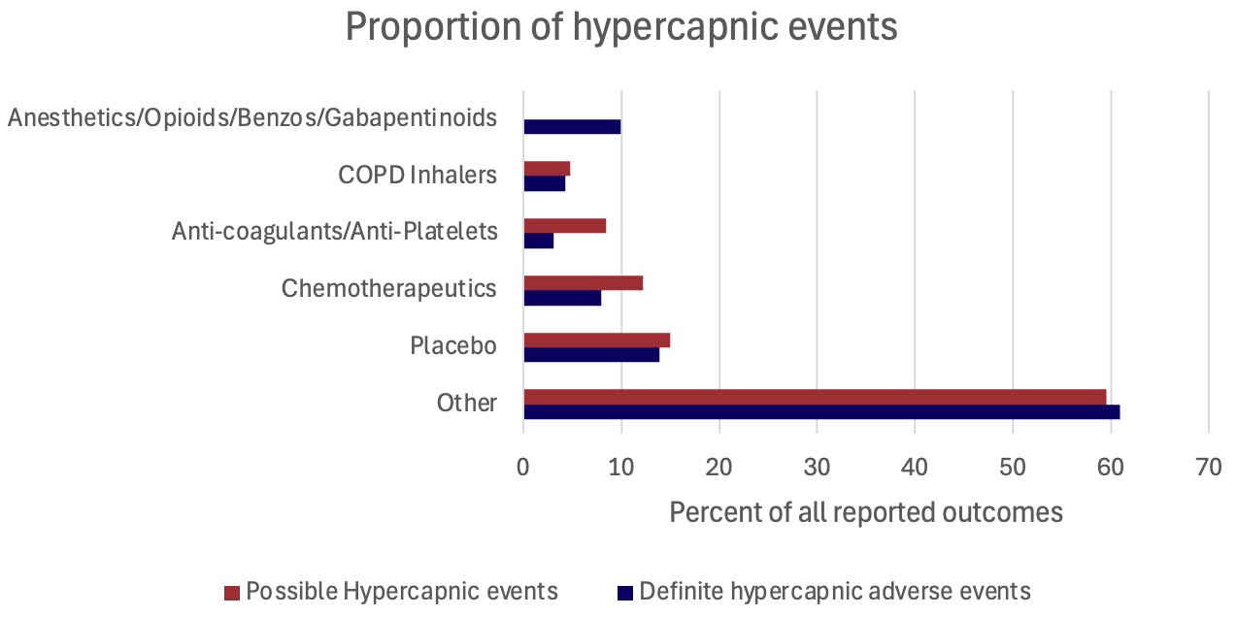


Preparing your poster for printing:
Go to File > Save As. Under Save as type (Windows) or Format (OS X), select PDF.
Open the PDF in Adobe Photoshop. Go to File > Save As. Under Format, select JPEG or TIFF. Choose a location and file name for your file and click Save. Click OK on the default save settings.
DO NOT SAVE TO A JPEG OR TIFF FROM POWERPOINT!
HYPERCAPNIC RESPIRATORY FAILURE IS INFREQUENTLY REPORTED AS AN ADVERSE EVENT IN CLINICAL TRIALS
Dustin Anderson-Bell MD¹, Brian W Locke MD MSc^{,2}
University of Utah Health, Division of Pulmonary and Critical Care; Intermountain Medical Center, Division of Pulmonary and Critical Care
INTRODUCTION
RESULTS/DISCUSSION
Many medications cause respiratory depression.
This has often been recognized only after their widespread adoption.
Trials must report all detected life-threatening adverse events to clinicaltrials.gov.
Study Question:
How often do trials report adverse events plausibly related to respiratory depression, hypercapnia, or hypoventilation?
6,429 finished trials (4,863,170 participants)
5,300 unfinished trials (4,097,827 participants)
At least one definite hypercapnia event:
242 (3.8%) of completed trials
139 (2.6%) of unfinished trials
At least one possible hypercapnia event:
663 (10.3%) completed trials
355 (6.6%) unfinished trials
Total definite: 815 (0.02% of all events)
Total possible: 3539 (0.1% of all events).
Benzodiazepine, Opioid, Gabapentinoids, Anesthetics: 91 definite, 0 possible events.
High-risk patients with low-risk medications (ie chemotherapeutics: 74 definite, 432 possible)
Placebo arms: 113 definite, 2107 possible events.
48 inches wide X 36 inches high
METHODS
Clinicaltrials.gov data through Dec 25th, 2022 parsed by Shi and Du (Scientific Data; 2024) who used BioBERT to extract trial elements from each registration.
Adverse events were classified as not related, possibly related, or definitively related to respiratory depression.
Studies were categorized by:
Condition under study
Class of medication or intervention
If they’ve reported final outcomes
Definite: Specific key words such as hypercapnia, hypercarbia, hypoventilation, respiratory acidosis.
Possible: More general key words such as acute respiratory failure, respiratory arrest, dependence on ventilator.
Figure 1: Source trials and event totals
CONCLUSIONS
Hypoventilation-related adverse events are sporadically reported in clinical trials.
Many reported adverse events are unlikely adverse drug reactions.
Possible explanations include: studying healthy patients, insensitivity of passive data monitoring, under-representation of respiratory depressants
Reliable capture of hypoventilation events in trials might allow earlier identification of risky medications.
Figure 2: Relative contribution of
anesthetics/opioids/benzodiazepines/gabapentinoids vs
COPD inhalers, chemotherapeutics, placebo, and other interventions
to reported hypercapnic events
Supported by the American Thoracic Society Academic Sleep Pulmonary Integrated Research/Clinical Fellowship (ASPIRE) Fellowship, the National Institutes of Health under Ruth L. Kirschstein National Research Service Award 5T32HL105321, and the Intermountain Fund (B.W.L.). Disclosure: B.W.L claims an ownership in Mountain Biometrics (clinical machine learning unrelated to the current project)

